Slide 1
ASSIGNMENT ON EXPLORING THE DATA GEOGRAPHICALLY
Submitted By: Pooran Pragnya
November Batch (BDS)

Slide 2
Tableau helps us to create geographically map for the data.
Tableau has already assigned the proper geographic roles to the country, state, city and postal code fields that’s because it recognized that each of those fields contained geographic data.
Tableau is designed to make the most of geospatial data, so you can get to the “where” as well as the “why.” With instant geocoding, you can automatically turn the location data and information you already have into rich, interactive maps.
Census-based population, income, and other standard demographic datasets are built-in so exploring the data becomes a breeze with just a few clicks.

Slide 3
Scenarios
Create a map view to represent all the states with country
Check your map for south region
Check the sales for south region
Find the state that has highest sales
Represent the sales in USD
Edit color for the map
Show the profit for all the states in the map for south region.
Find out the name of states having negative profit.
Note down the name of the sates having lowest and highest profit.

Slide 4
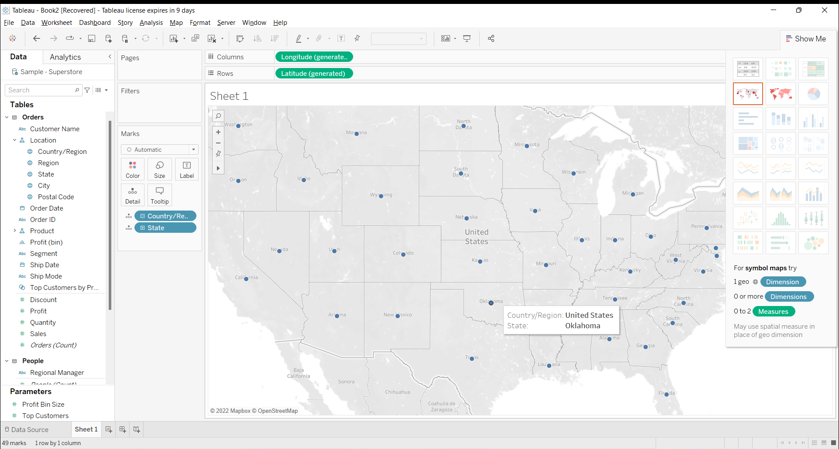
1. Create map view to represent all the states with the country

Slide 5
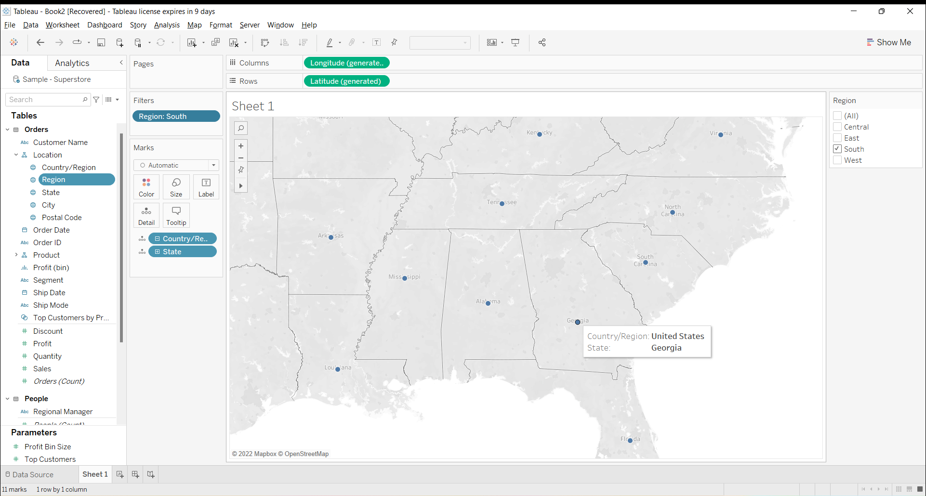
2. Check the map for south region

Slide 6
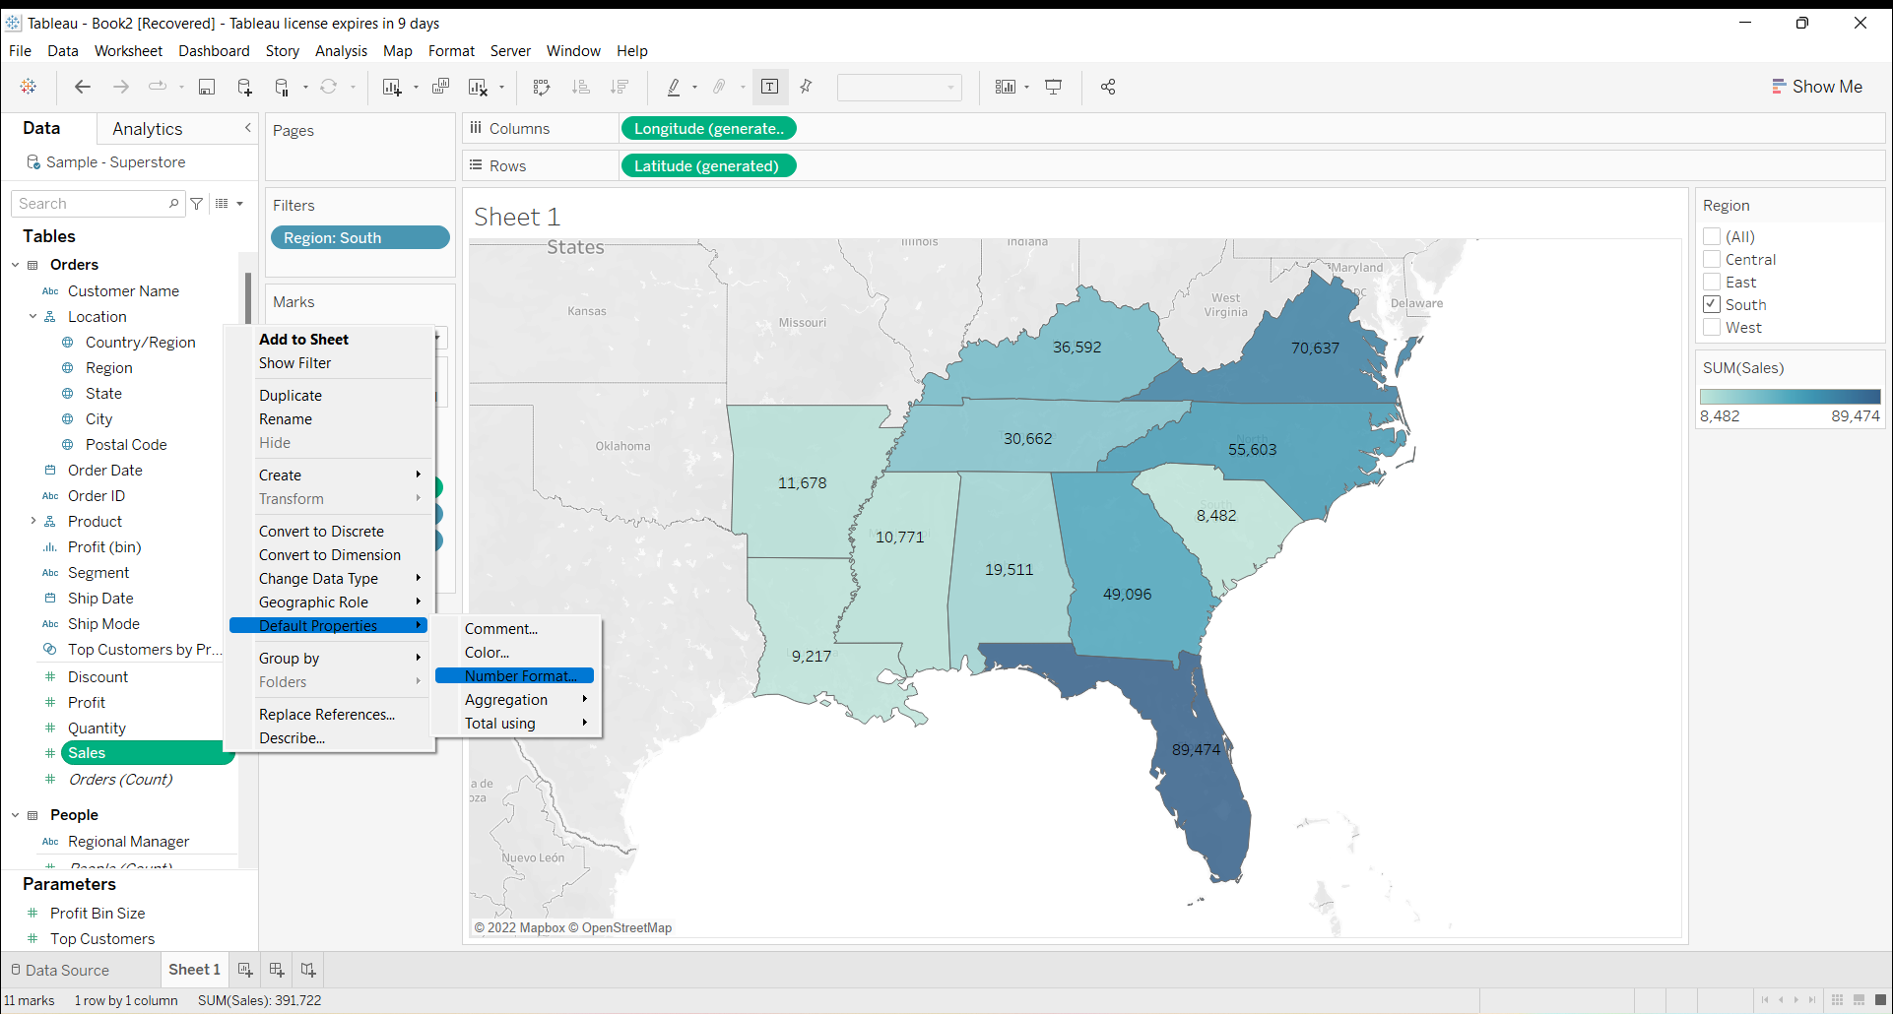
3. Check the sales for south region

Slide 7
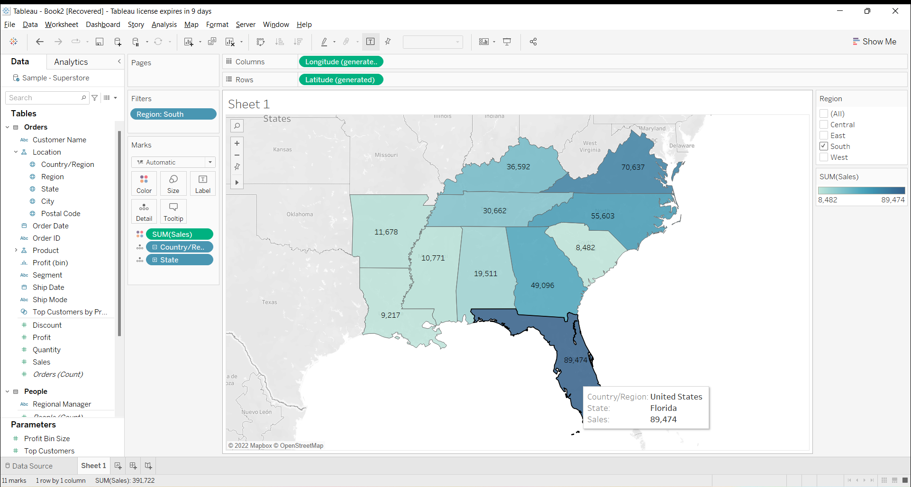
4. Find the state that has highest sales

Slide 8
5. Represent the sales in USD
Click on ‘sales’
Default Properties
Number Format
Currency (custom)
Add Dollar then press Ok

Slide 9
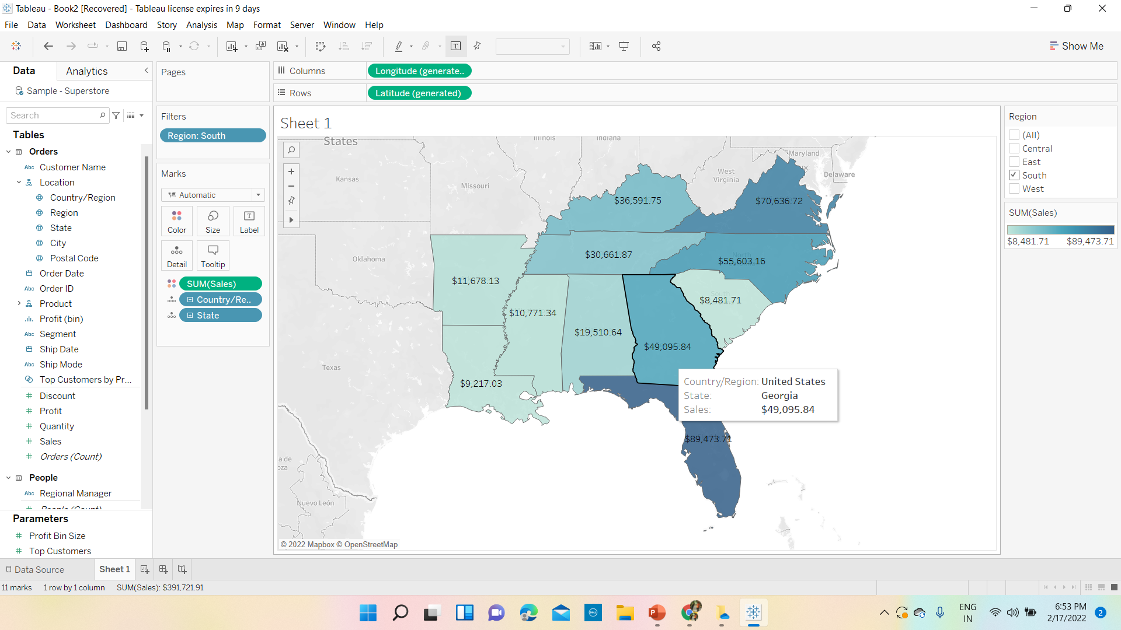

Slide 10
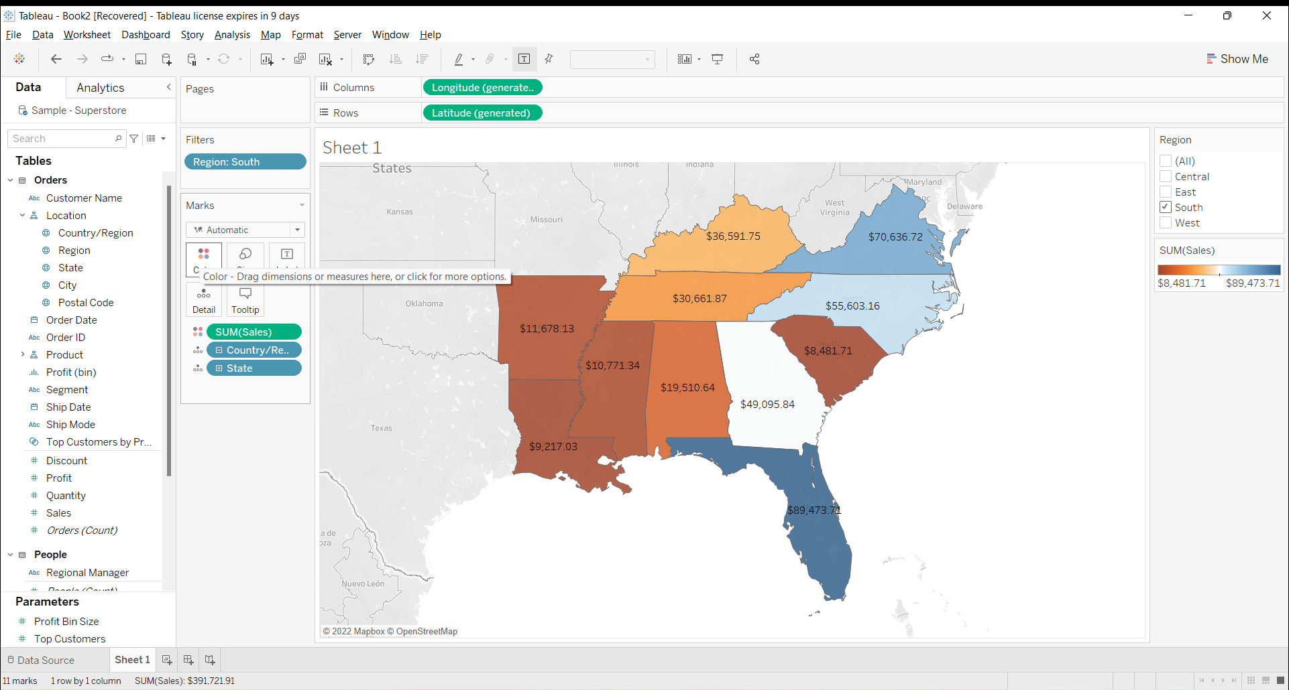
6. Edit color for the map

Slide 11
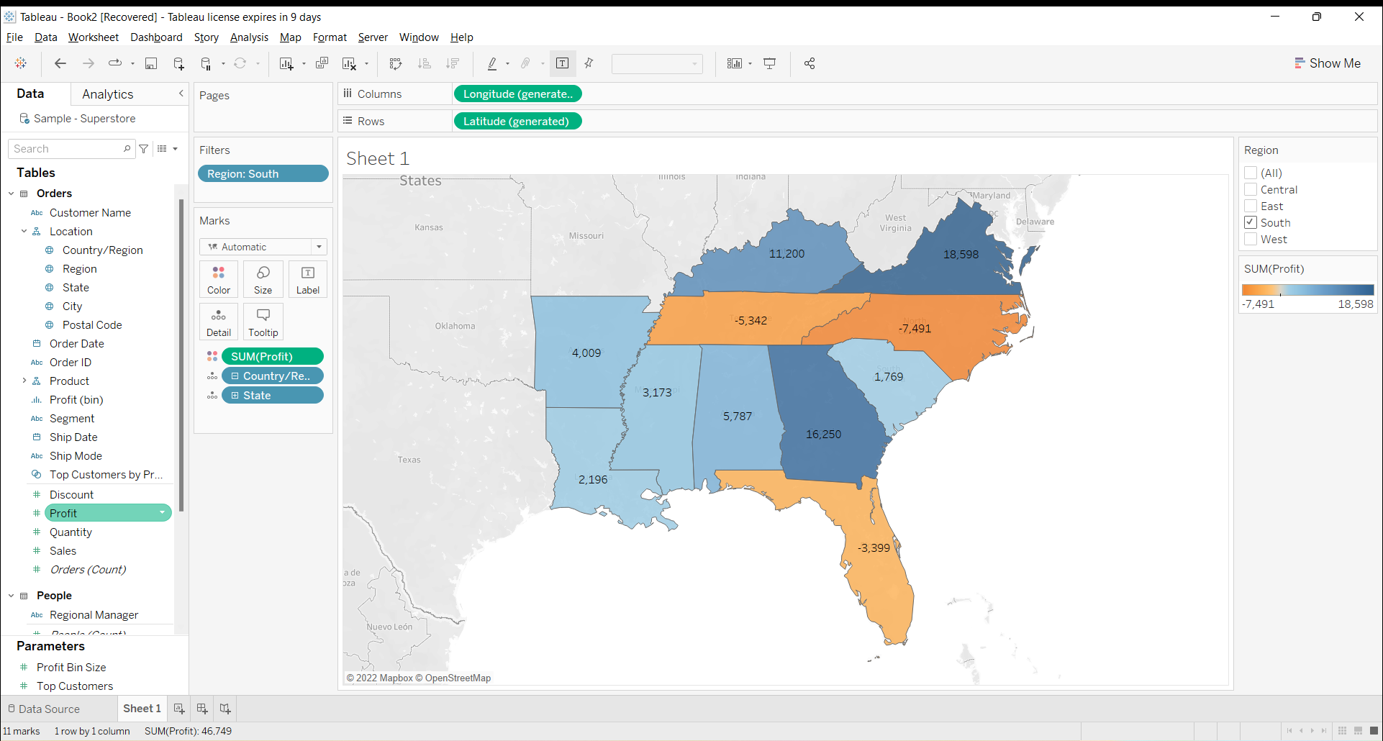
7. Show the profit for all the states in the map for south region

Slide 12

8. Find out the name of states having negative profit.

Slide 13
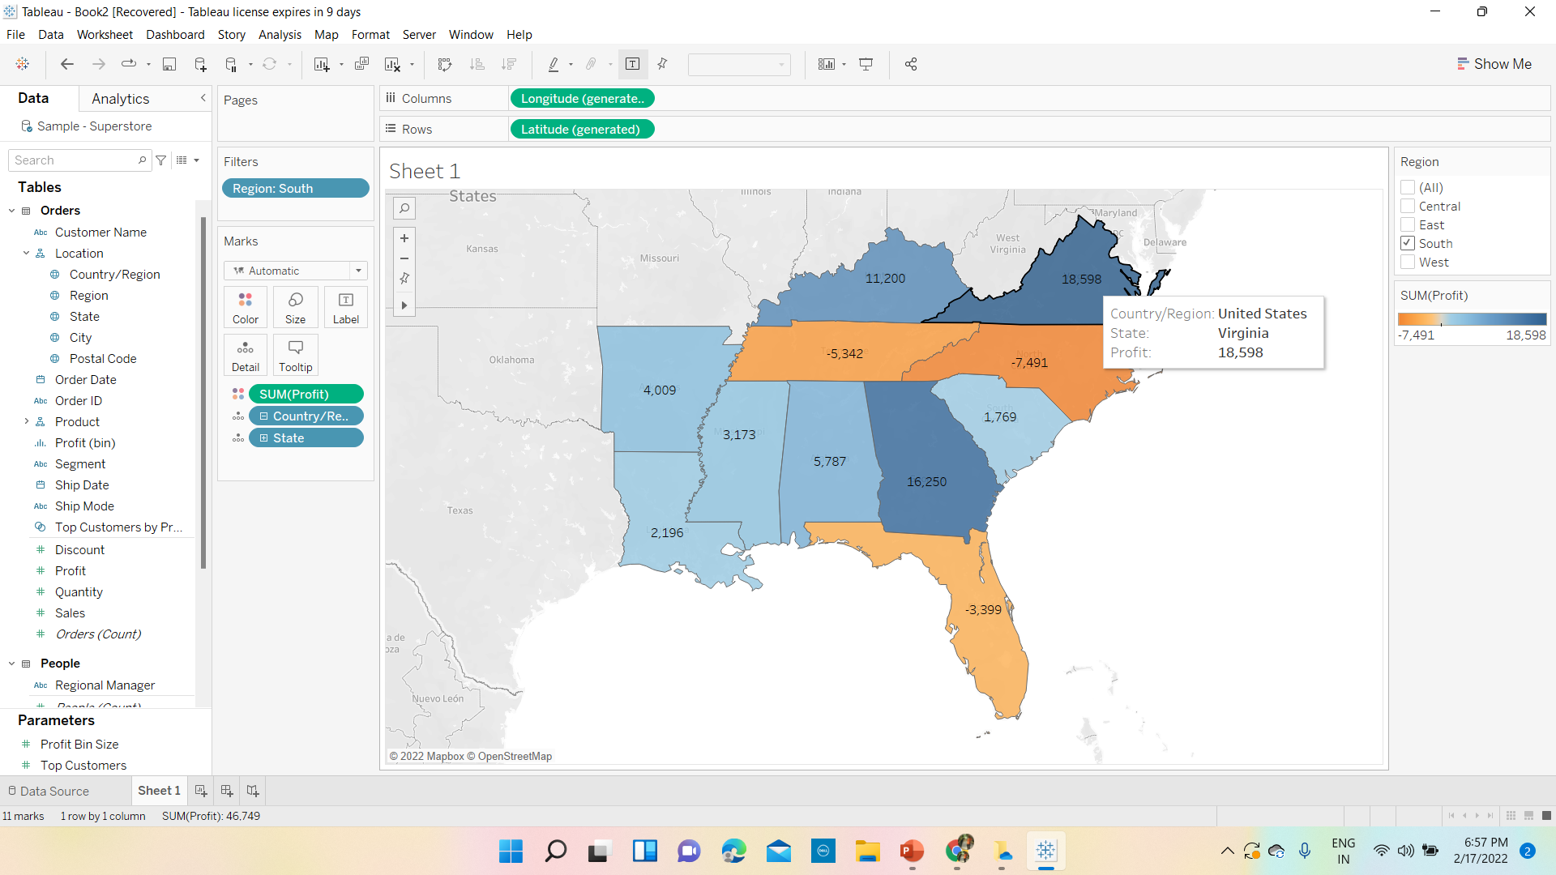
9. Name the states having lowest profit and highest profit

